Slide 1
HTML Table and List

Slide 2
Table Tag
The table tag displays information in rows and columns.
The <table> tag is a container tag

Slide 3
Table structure

Slide 4
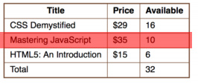
Rows
The rows run horizontally from left to right. Our table above has four rows. Here is the table with the second row highlighted.
a single row is represented by the <tr> tag.

Slide 5
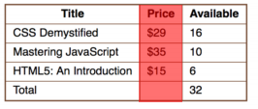
Columns
The columns run vertically from top to bottom. The table above has three columns. Here is the table with the third row highlighted.
A table column doesn’t have a specific tag. However, in case you need to control a specific column, there are certain Cascading Style Sheets (CSS) tricks which you can use. We shall look at this later.

Slide 6
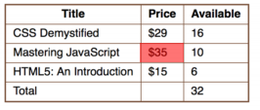
Cells
The cells are the little boxes which make up the table. This is where you insert your data. Our table has 12 cells. Here is the table with the second cell in the first row selected.

Slide 7
Cell
A single cell is represented by either a <td> or <th> tag. A <td> tag (the “td” stands for “table data”) is used for inserting data into the table. A <th> tag (the “th” stands for “table header”) is used for inserting headings into the table

Slide 8
Creating A Table

Slide 9
Output

Slide 10
There are three key things you need to note here:
1. The table begins and ends with the <table> tag. This is what indicates to the browser to insert the table.
2. Each row in the table is represented by the <tr> tag. In fact, creating a table is often a matter of stacking different rows, one on top of another.
3. Each cell in the table is represented by the <td> tag. The contents of each cell is typed between the opening and closing <td> tag.

Slide 11
Table Borders

Slide 12
Output

Slide 13
Regions in a table
HTML5 introduced a way of segregating a table into regions: the head, body and foot. These regions are represented by the following tags:
<thead> – is the head of the table. This area usually contains the column headings
<tbody> – is the body of the table. The table data.
<tfoot> – is the foot of the table. The summary, other footer information goes here

Slide 14
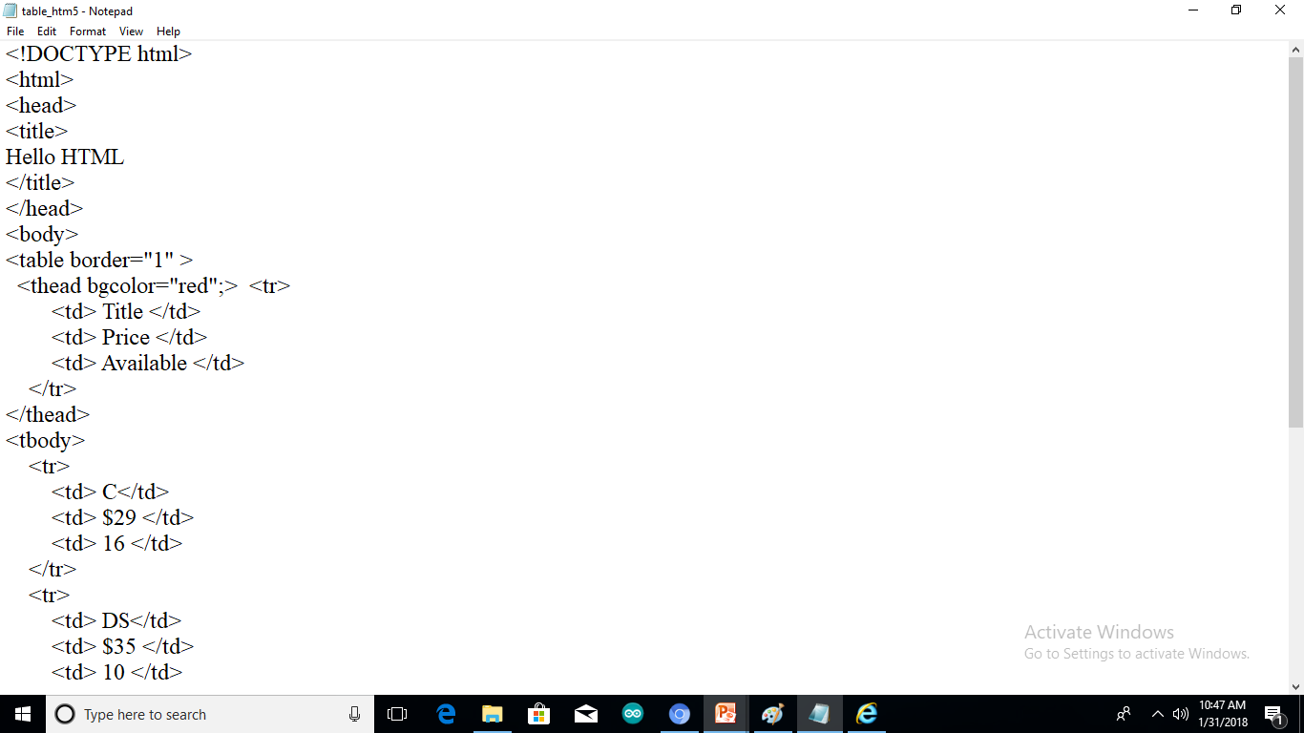

Slide 15
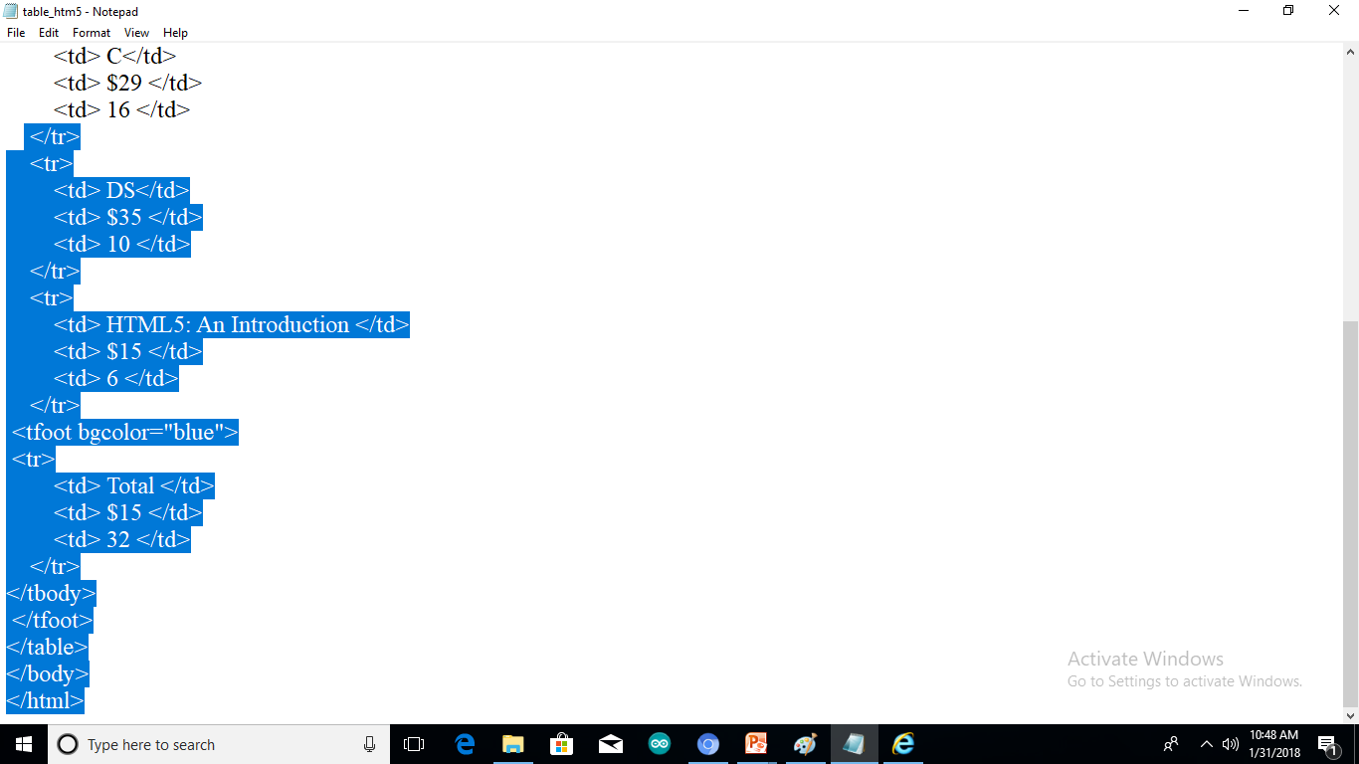

Slide 16
Output

Slide 17
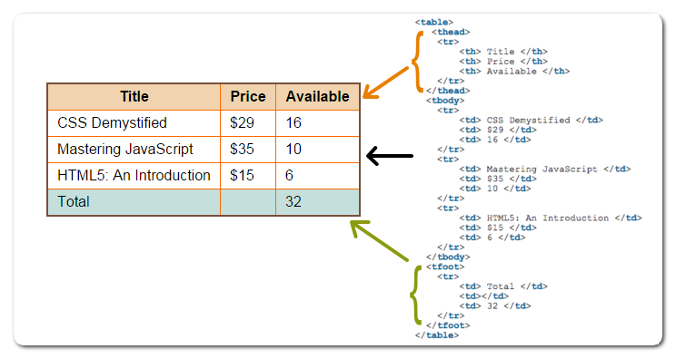

Slide 18
<th> tag
The th tag for heading cells
Notice the <th> tag in the sample code above. The th tag is used to mark the heading of the row/column.

Slide 19
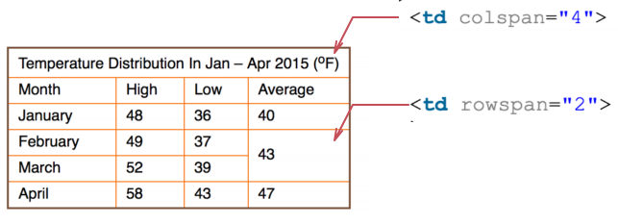
Merging Cells
It is possible to merge multiple cells in to one. You do this by combining the cells into one cell. See this table for example:

Slide 20
Merging columns
To merge different cells on a given row, you use the “colspan” attribute of the
tag. The colspan attribute takes a number as a value (e.g. colspan= “5”). This number represents the number of columns a given cell should cover (span).
<tr>
<td colspan="4">
Temperature Distribution In Jan – Apr 2015
</td>
</tr>

Slide 21
Merging Rows
In order to merge two or more cells in the same column, you use the “rowspan” attribute. This attribute is similar to the colspan, except that it applies to rows. For instance, the average temperatures of February and March are merged as follows
<tr>
<td> February </td>
<td> 49 </td>
<td> 37 </td>
<td rowspan="2"> 43 </td>
</tr>
<tr>
<td> March </td>
<td> 52 </td>
<td> 39 </td>
</tr>

Slide 22
Table Caption
We used a single row to explain the purpose of the table. It is possible to add a caption to the table, which will be more semantically right.

Slide 25
Cell padding and Cell spacing

Slide 26
Before Cell padding and cell spacing

Slide 27
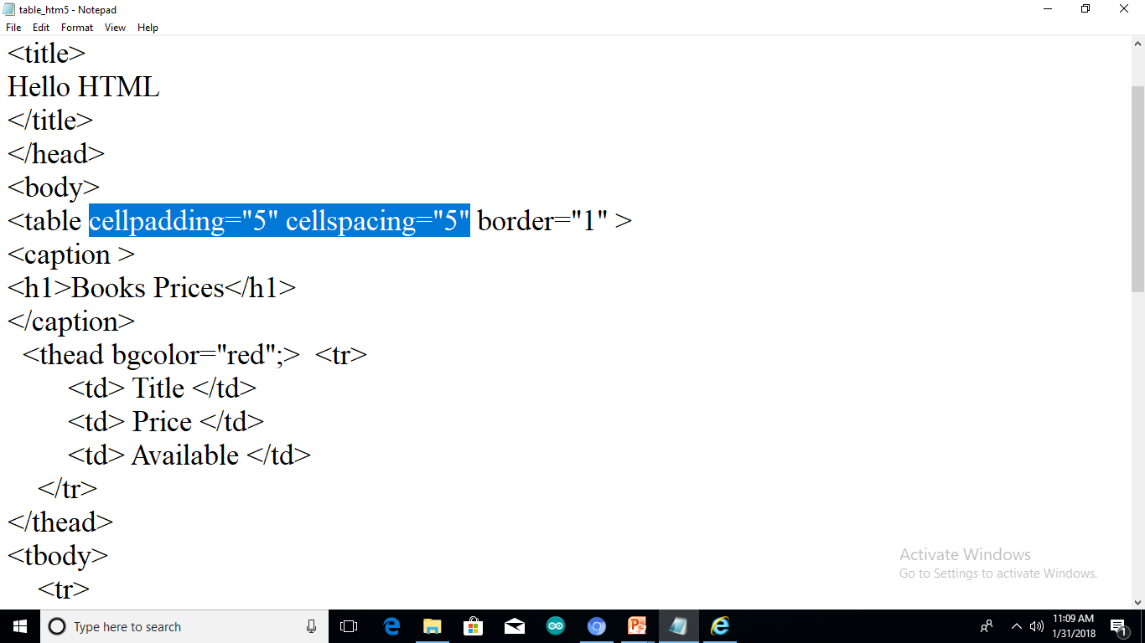

Slide 28
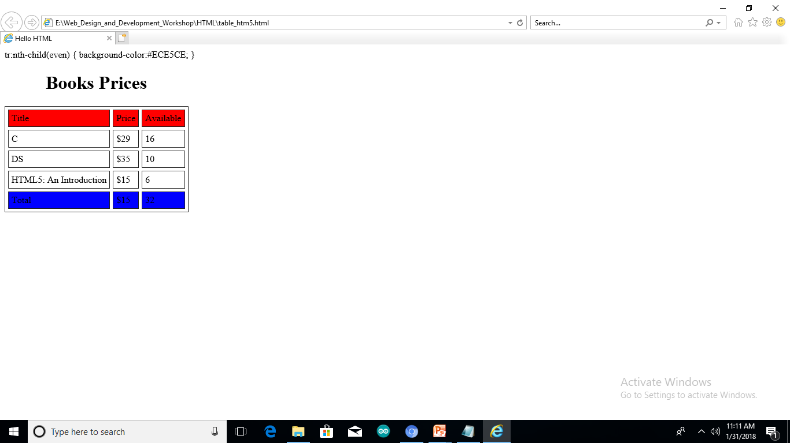

Slide 29
<colgroup> Tag
The <colgroup> tag specifies a group of one or more columns in a table for formatting.
The <colgroup> tag is useful for applying styles to entire columns, instead of repeating the styles for each cell, for each row.
Note: The <colgroup> tag must be a child of a <table> element, after any <caption> elements and before any <thead>, <tbody>, <tfoot>, and <tr> elements.
Tip: To define different properties to a column within a <colgroup>, use the <col> tag within the <colgroup> tag.

Slide 30
Colgroup

Slide 31
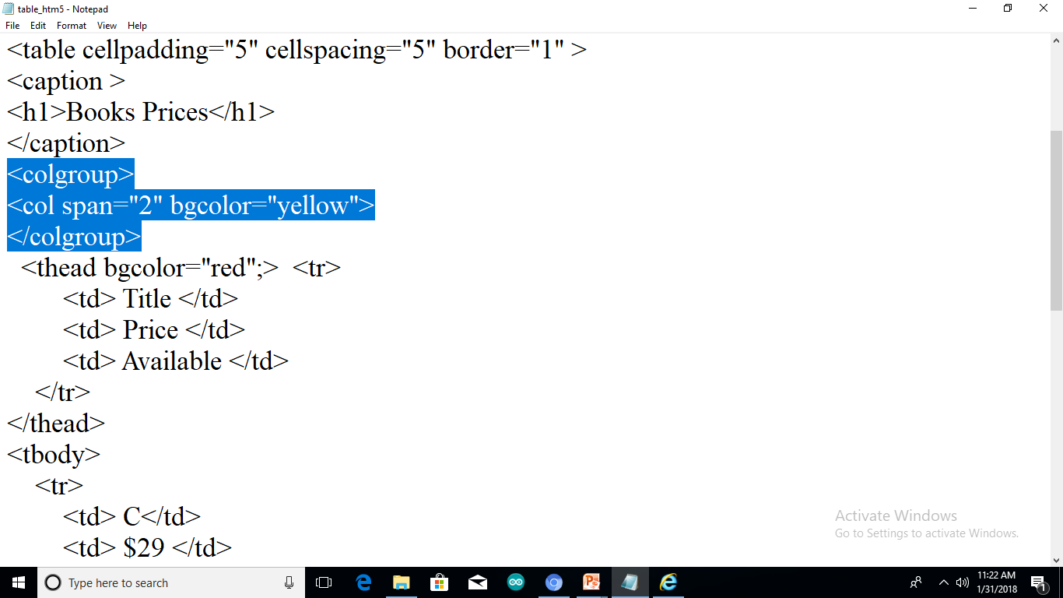
Col

Slide 33
Text Alignment

Slide 34
Assignment-1
Row 1 - Col 1 | Row 1 - Col 2 | Row 1 - Col 3 | Row 1, 2, 3 & 4 - Col 4
Row 2 - Col 1 | Row 2, 3 & 4 - Col 2 & 3
Row 3 - Col 1
Row 4 - Col 1
Row 5 - Col 1 & 2 |  | Row 5 - Col 3 & 4
Row 6 - Col 1, 2, 3 & 4

Slide 35
HTML Lists
Unordered List
Ordered List
DeSCRIPTION List

Slide 36
Unordered
An unordered list starts with the <ul> tag. Each list item starts with the <li> tag.
The list items will be marked with bullets (small black circles) by default:
Example
<ul> <li>Coffee</li> <li>Tea</li> <li>Milk</li> </ul>

Slide 37
Type Property
Value | Description
disc | Sets the list item marker to a bullet (default)
circle | Sets the list item marker to a circle
square | Sets the list item marker to a square
none | The list items will not be marked

Slide 38
Example
<html>
<body>
<h2>Unordered List with Disc Bullets</h2>
<ul type=‘dics’>
<li>Coffee</li>
<li>Tea</li>
<li>Milk</li>
</ul>
</body>
</html>

Slide 39
Ordered List
An ordered list starts with the <ol> tag. Each list item starts with the <li> tag.
The list items will be marked with numbers by default:
<ol> <li>Coffee</li> <li>Tea</li> <li>Milk</li> </ol>

Slide 40
Type Attribute
Type | Description
type="1" | The list items will be numbered with numbers (default)
type="A" | The list items will be numbered with uppercase letters
type="a" | The list items will be numbered with lowercase letters
type="I" | The list items will be numbered with uppercase roman numbers
type="i" | The list items will be numbered with lowercase roman numbers

Slide 41
Example 2
<html>
<body>
<h2>Unordered List with Disc Bullets</h2>
<ul type=‘dics’>
<li>Coffee</li>
<li>Tea</li>
<li>Milk</li>
<ul type=‘circle’>
<li>Apple</li>
<li>Mango</li>
</ul>
</ul>
</body>
</html>

Slide 42
HTML Layouts
Header
Home Aboutus Registration Contactus | Amity University:
@CopyRight

Slide 43
Example-1
<!DOCTYPE html>
<html>
<body>
<h2>Ordered List with Numbers</h2>
<ol type="1">
<li>Coffee</li>
<li>Tea</li>
<li>Milk</li>
</ol>
</body>
</html>

Slide 44
Description Lists
HTML also supports description lists.
A description list is a list of terms, with a description of each term.
The <dl> tag defines the description list, the <dt> tag defines the term (name), and the <dd> tag describes each term:

Slide 45
Example
<!DOCTYPE html>
<html>
<body>
<h2>A Desription List</h2>
<dl>
<dt>Coffee</dt>
<dd>- black hot drink</dd>
<dt>Milk</dt>
<dd>- white cold drink</dd>
</dl>
</body>
</html>

Slide 46
Nested Lists
<!DOCTYPE html>
<html>
<body>
<h2>A Nested List</h2>
<ul>
<li>Coffee</li>
<li>Tea
<ul>
<li>Black tea</li>
<li>Green tea</li>
</ul>
</li>
<li>Milk</li>
</ul>
</body>
</html>

